Slide 1
Mechanisms and Robotics DE ES DM ZG561
Lecture - 2
Dr. Glynn John
Mechanical Engineering

Slide 2

Fundamentals of Robot Technology
Robot Anatomy
Arm Configuration
Joint Notation scheme
Degrees of Freedom (DOF)
Required DOF in a Manipulator

Slide 3
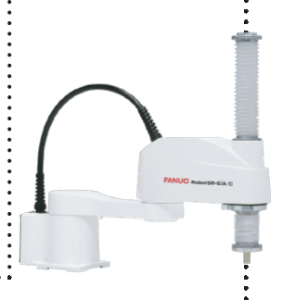

Can you identify a robot type?
Can you identify the robot type?
Can you determine if a given robot can be used to automate a particular task?

Slide 4
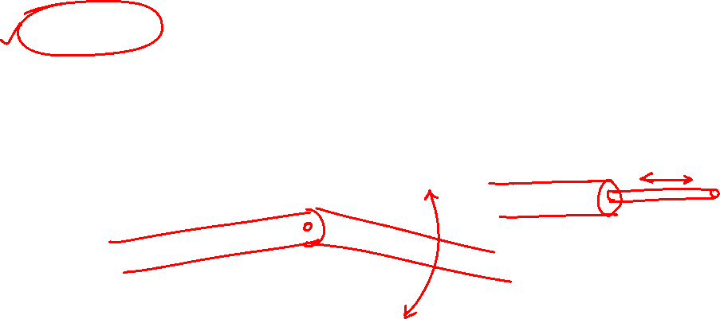
Links, Joints and Joint Notation Scheme
Types of Robot Joints
Type | Notation | Symbol | Description
Revolute | R |  | Rotary motion about an axis
Linear (Prismatic) | L |  | Linear motion along an axis

Slide 5
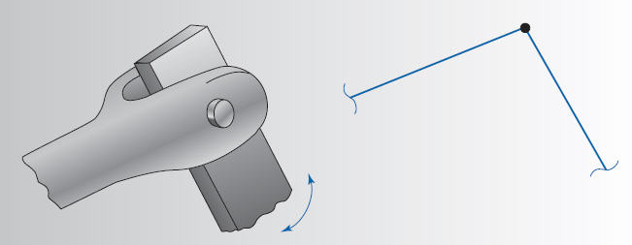
Types of Robot Joints
Pin Joint
(Revolute)

Slide 6
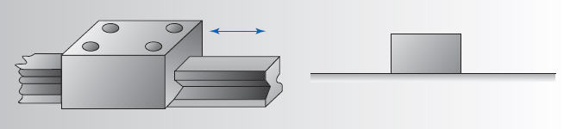
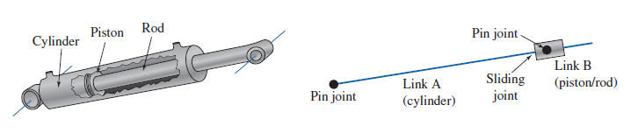
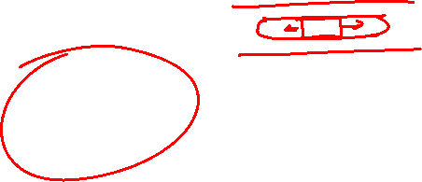
Types of Robot Joints
Prismatic Joint

Slide 7
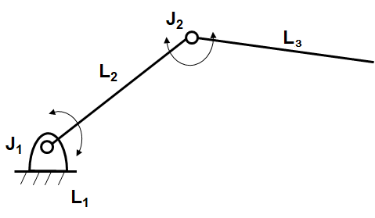
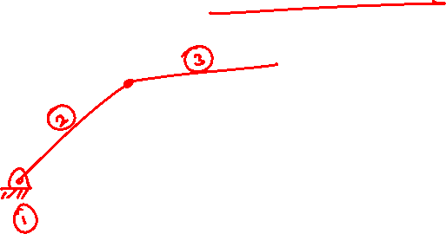
Degrees of Freedom
Consider an open kinematic chain as shown below.
Link-2 is connected to the ground link-1 by a revolute joint.

Slide 8
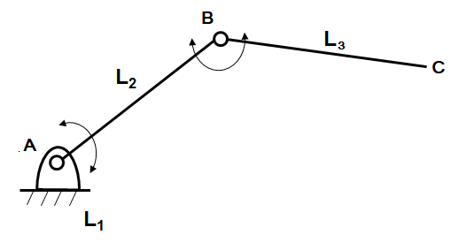

Degrees of Freedom
Thus in an n-DOF robotic manipulator n joints are used and n independent joint-link variables are required to completely specify the position and orientation of the each link.
Hence for example in case of two DOF manipulator shown in figure two joint-link variables are required to define the position and orientation of the end point C.

Slide 9
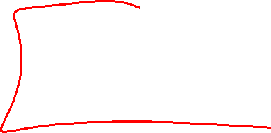
Degrees of Freedom
Hence link-2 can rotate about joint-1 w.r.t. ground link and contributes one degree of freedom.
Similarly link-3 can rotate about joint-2 w.r.t. link-2.
Or link-3 has one degree of freedom w.r.t. link-2.
Therefore this open loop chain has as many degrees of freedom (DOF) as the number of joints in the chain, as each joint is of one DOF.

Slide 10
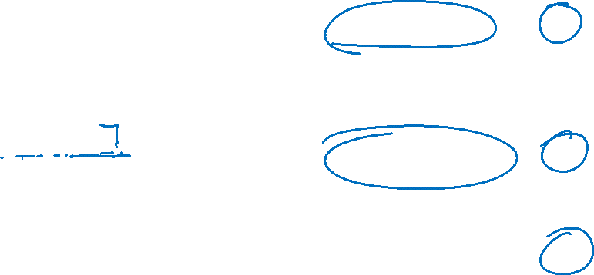

Further classification of revolute Joints
prismatic joint
L
rotational joint
R
revolving joint
V
twisting joint
T

Slide 11
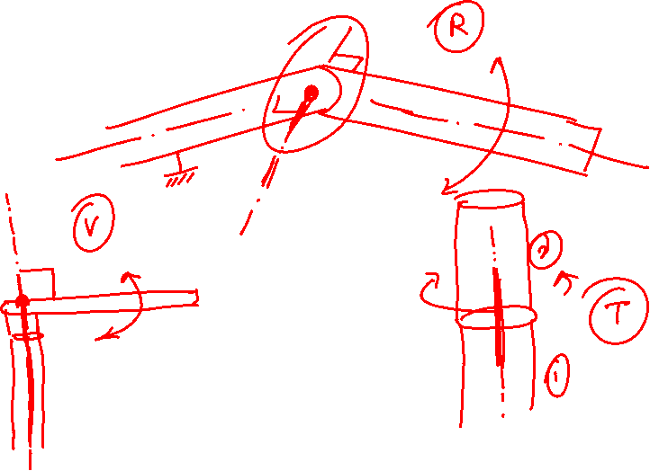
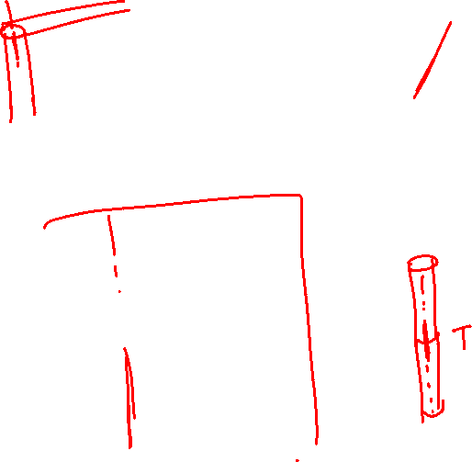

Slide 13
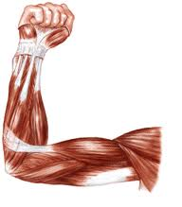

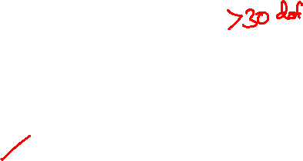
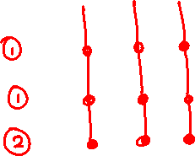
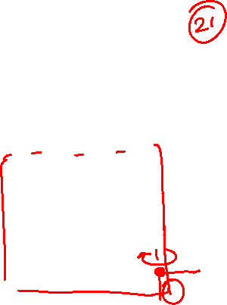
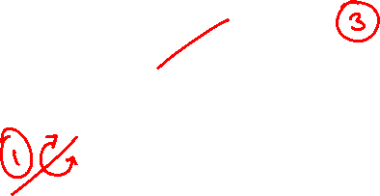
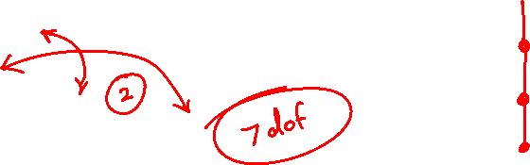


Human Arm Characteristics

Slide 14
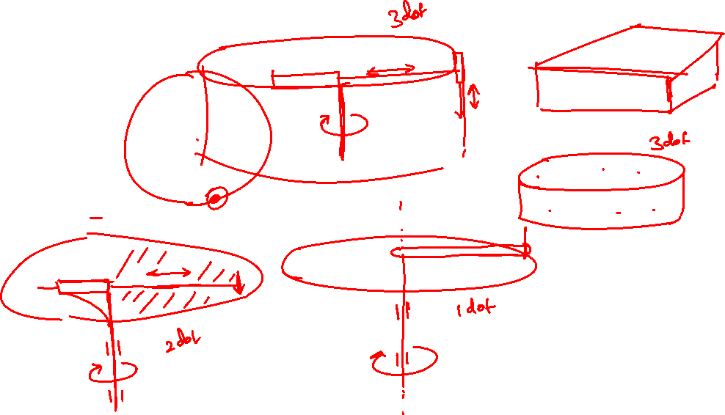

Slide 15

Required Degrees of Freedom
For moving objects placed on a line or a circle → 1 dof
For moving objects anywhere on a flat surface → 2 dof
Picking objects anywhere on a 3D space → 3 dof
Reaching in to complex profiles → > 3 dof

Slide 16


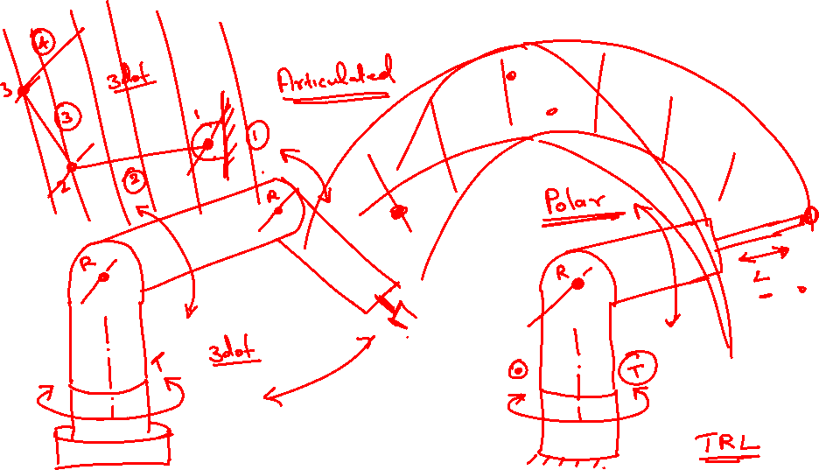
Arm Configurations

Slide 17
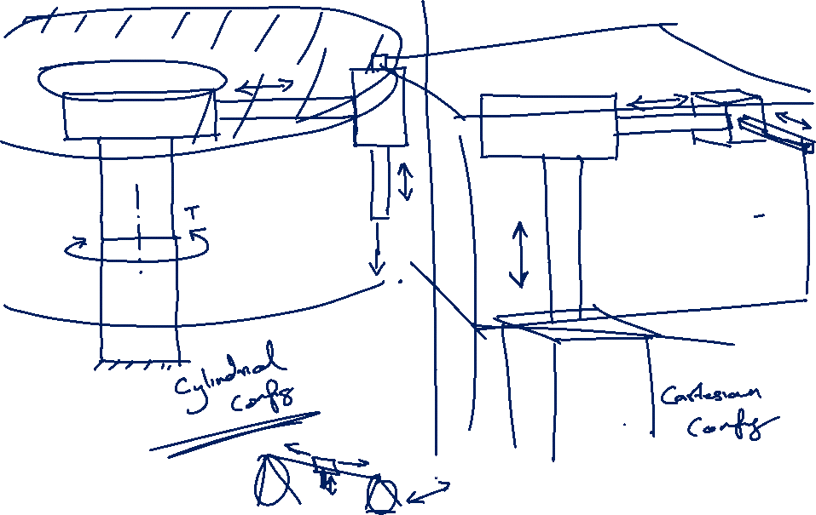
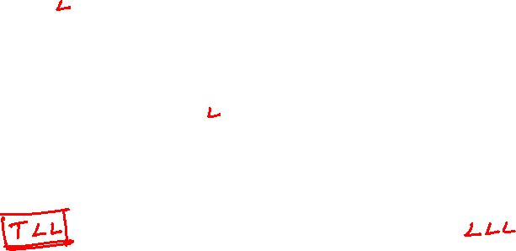
Arm Configurations

Slide 18
Joints and Joint Notation Scheme
Types of Robot Joints
Type | Notation | Symbol | Description
Revolute | R |  | Rotary motion about an axis
Prismatic | P or L |  | Linear motion along an axis

Slide 19
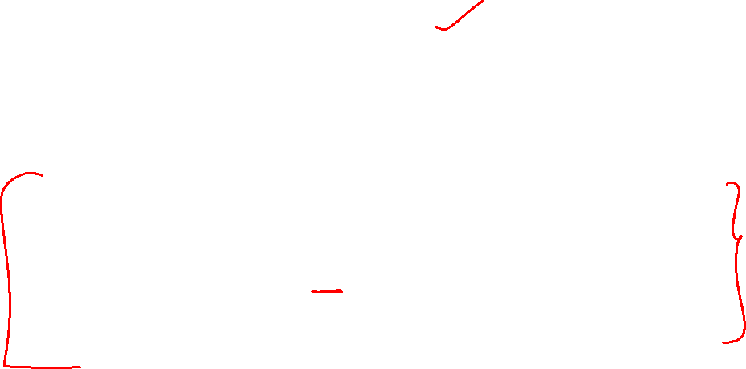
Arm Configurations
S. No. | Configuration | Joints
1. | Cartesian | (3 Linear joints)
2. | Cylindrical | (2 Linear joints, 1 Rotary Joint)
3. | Polar (Spherical) | (1 Linear joint, 2 Rotary joints)
4. | Articulated (jointed arm) | (3 Rotary Joints)

Slide 20
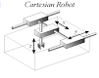
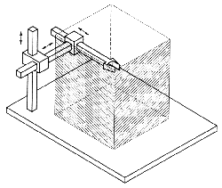

Robot Configurations and Work Envelope
Cartesian
Work Volume or Work Envelope is a term that refers to the space within which a robot can manipulate its wrist’s end

Slide 21
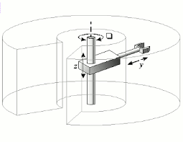
Robot Configurations and Work Envelope
Cylindrical

Slide 22
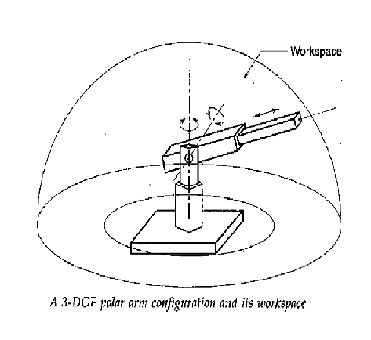
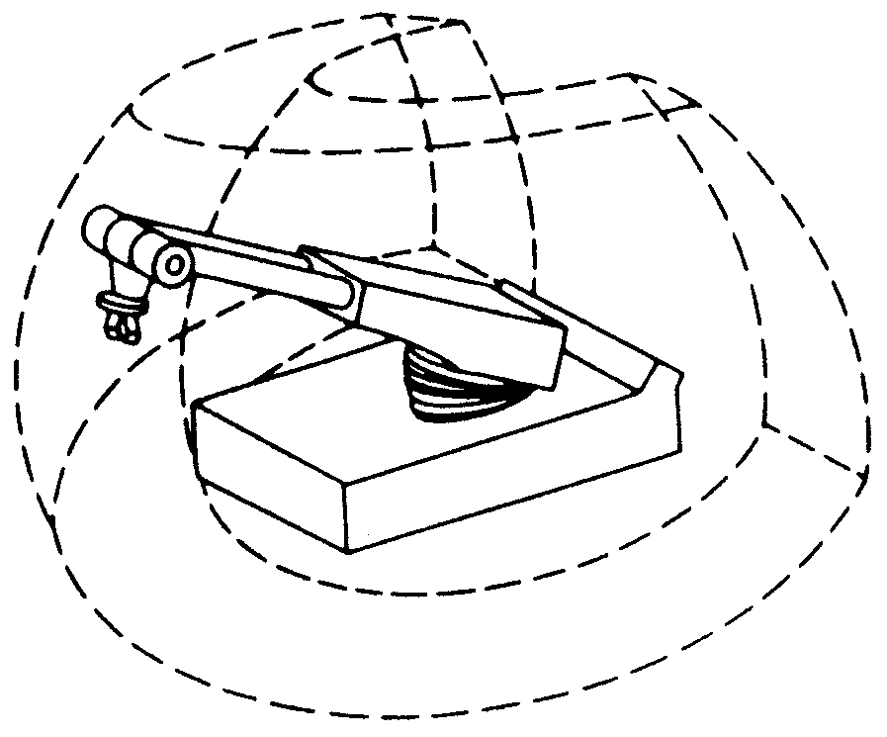

Robot Configurations and Work Envelope
Spherical or Polar

Slide 23
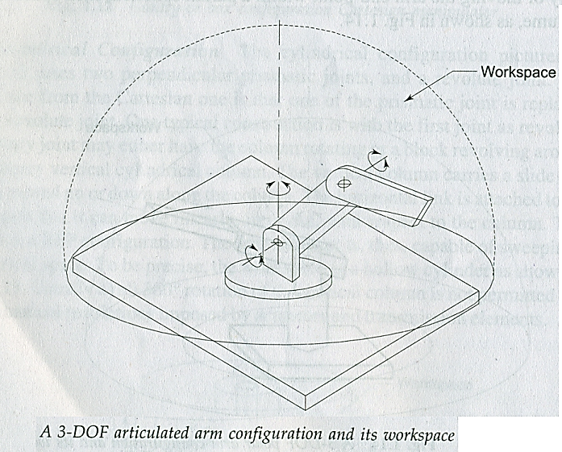
Robot Configurations and Work Envelope
Articulated or Jointed Arm Configuration

Slide 24
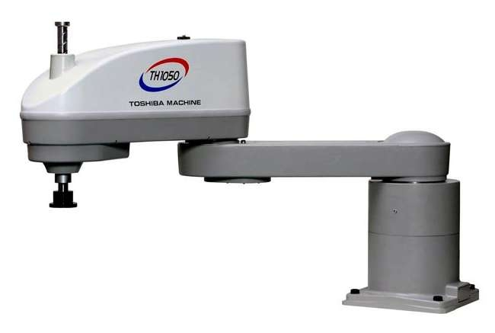
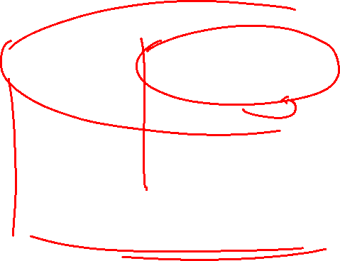
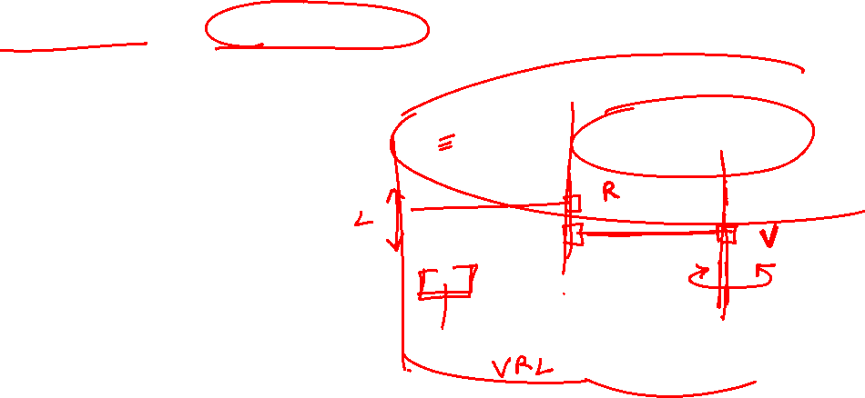

Robot Configurations and Work Envelope
SCARA (Selective compliance assembly robotic arm)
A variation of the cylindrical configuration, involving
1 linear joint and 2 rotary joints

Slide 25
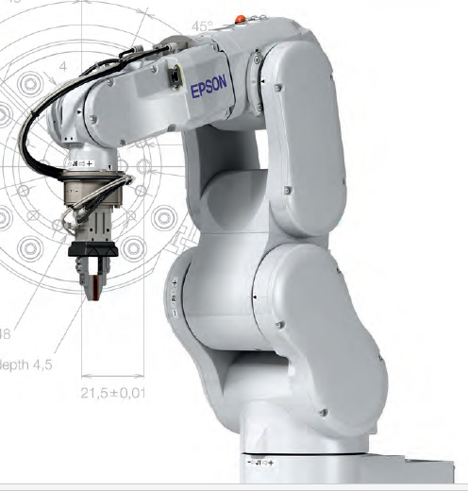
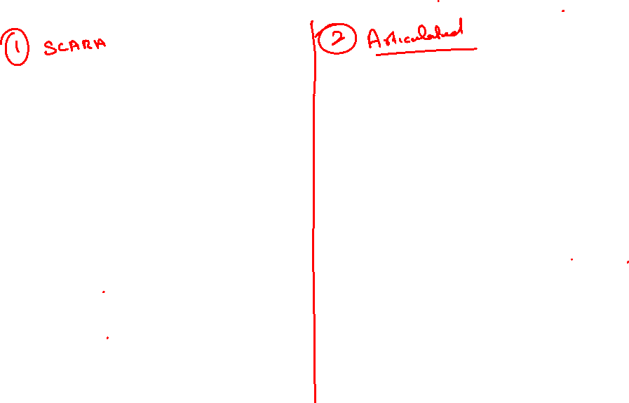
Guess the configuration

Slide 26
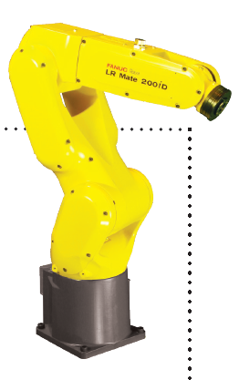
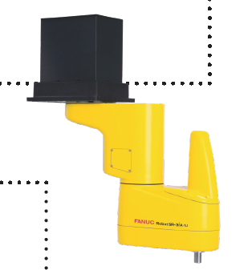
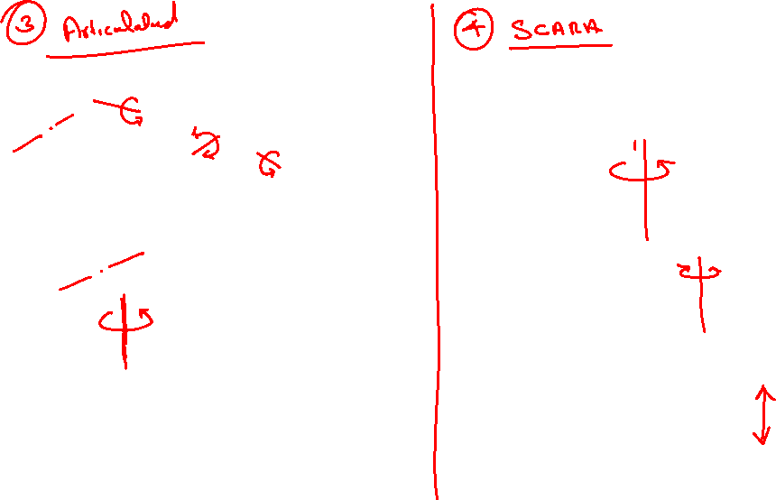
Guess the configuration

Slide 27
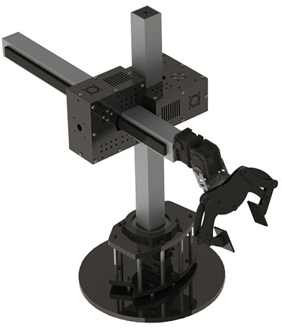
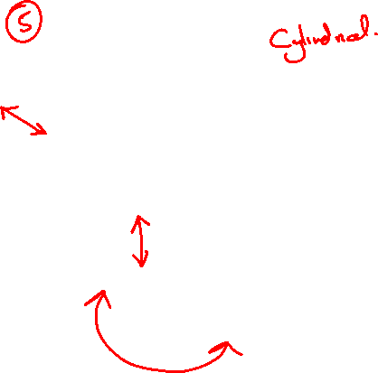
Guess the configuration

Slide 28
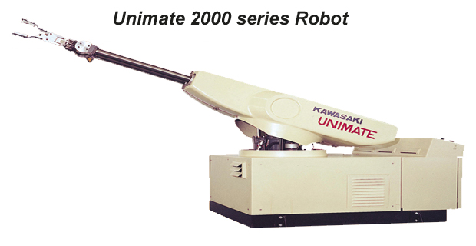
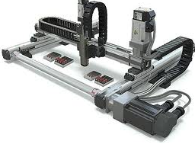
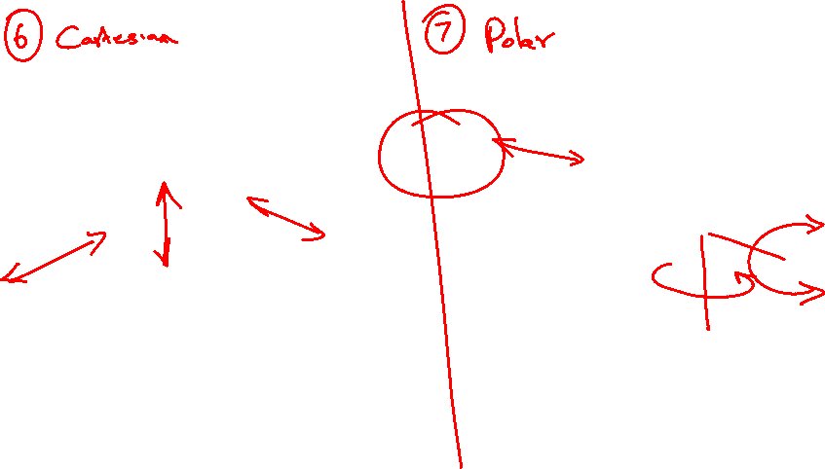
Guess the configuration

Slide 29
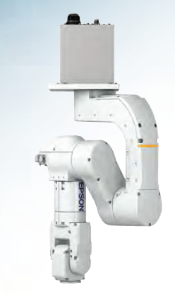
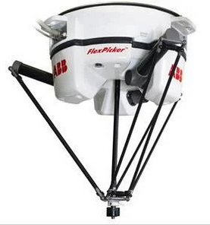
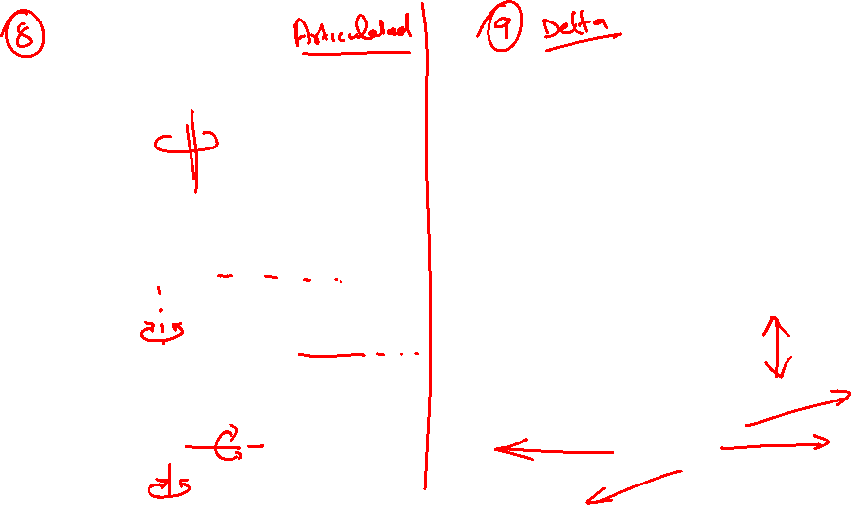
Guess the configuration

Slide 30
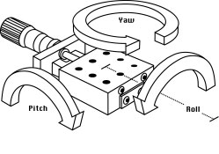
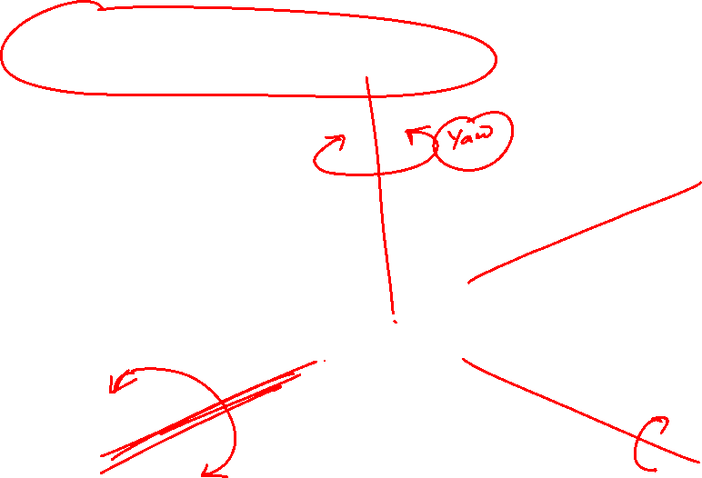

Wrist Movements

Slide 31
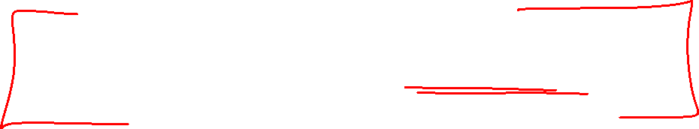
Degrees of Freedom
Degrees of freedom is often used to describe the number of directions that a robot can pivot or move a joint.

Slide 32
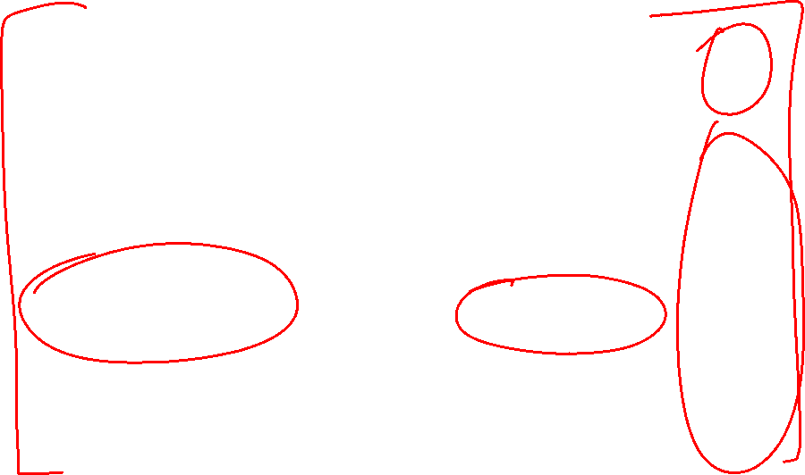
Further classification of Joints
prismatic joint
L
rotational joint
R
revolving joint
V
twisting joint
T

Slide 33


Joint Notation Scheme

Slide 34


Joint Notation Scheme

Slide 35


Joint Notation Scheme

Slide 36

Joint Notation Scheme

Slide 37

Sketch the following arm configurations
For the following arm and body designations describe the robots using sketches
LLR
RLR
LRR
LVR
LL - TRL

Slide 38


Slide 39


Slide 43
Required Degrees of Freedom
For moving objects placed on a line or a circle → 1 dof
For moving objects anywhere on a flat surface → 2 dof
Picking objects anywhere on a 3D space → 3 dof
Reaching into complex profiles → > 3 dof

Slide 44

Required Degrees of Freedom

Slide 45

Required Degrees of Freedom

Slide 46


Required Degrees of Freedom

Slide 47

Required Degrees of Freedom

Slide 48

Required Degrees of Freedom

Slide 49

Required Degrees of Freedom

Slide 50
THANK YOU
The presenter is grateful to the authors of the following textbooks.
Machines and Mechanisms, Applied Kinematic Analysis (Fourth Edition) – David H. Myszka
Industrial Robotics - Mikell P. Groover
Fundamentals of Robotics – Robert Schilling

